Slide 1
YOLO
You Only Learn Once

Slide 2
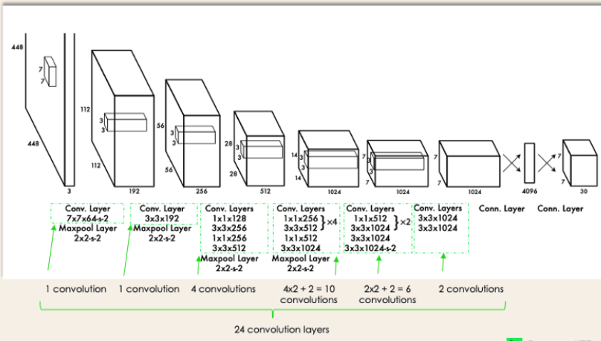
Algorithm to detect various objects in a picture
Employs CNN to detect objects in real time
Introduced in 2015
YOLO architecture from original paper

Slide 3
EVOLUTION OF YOLO
YOLO Version | Release Year | Speed (FPS) | mAP(COCO) | Backbone Network
YOLOv1 | 2016 | 45 | 63.4 | DarkNet-19
YOLOv2 | 2017 | 78 | 78.6 | DarkNet-19
YOLOv3 | 2018 | 62 | 82.1 | DarkNet-53
YOLOv4 | 2020 | 65 | 43.5 | CSPDarkNet-53
YOLOv5 | 2020 | 140 | 50.0 | CSPDarkNet-53
Here's what each column represents:
· YOLO Version: The version of YOLO being compared.
· Release Year: The year in which the YOLO version was released.
· Speed (FPS): The speed of the YOLO version in frames per second on a standard GPU.
· mAP (COCO): The mean average precision (mAP) of the YOLO version on the COCO dataset.
· Backbone Network: The backbone network used in the YOLO version.

Slide 4
How YOLO works?
YOLO works in 4 steps:-
Residual blocks
Bounding box Regression
Intersection over Union
Non Max Suppression

Slide 5
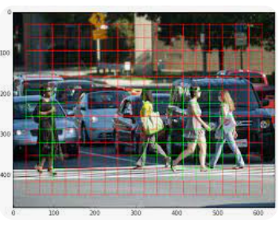
Residual Blocks
Image is divided into SxS grids
Each grid detects object that will appear within them

Slide 6
Bounding Box Regression
A bounding box is an outline that highlights an object in an image.
Attribute of every bounding box in the image:-
Width of bounding box wrt. enveloping grid cell(bw)
Height of bounding box wrt. enveloping grid cell (bh)
Probability score of grid containing an object(pc)
Class of object(c)
Bounding box center(bx,by)

Slide 7
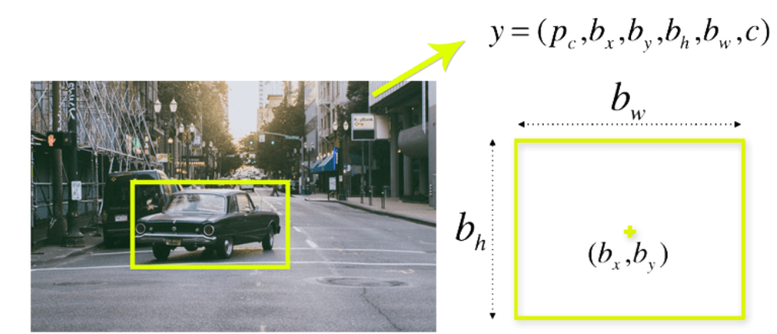
……contd
bx

Slide 8
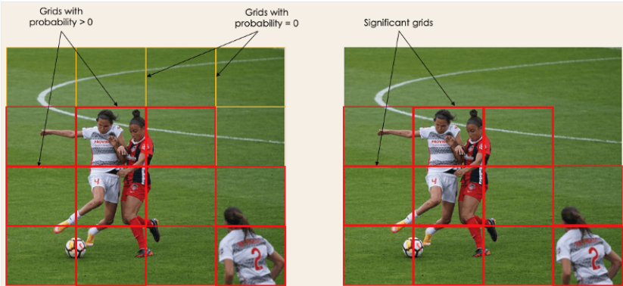

Slide 9
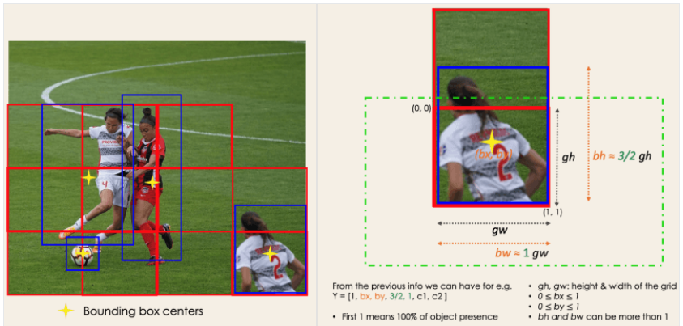

Slide 10
Intersection Over Union
It is a phenomenon in object detection that determines how boxes overlap.
It provides an output box that surrounds the object perfectly.
Each grid cell is responsible for predicting the bounding boxes and their confidence scores.
The IOU>threshold implies bounding box is same as real box
The mechanism eliminates bounding box that are not equal to real box.(IOU<= threshold)

Slide 11
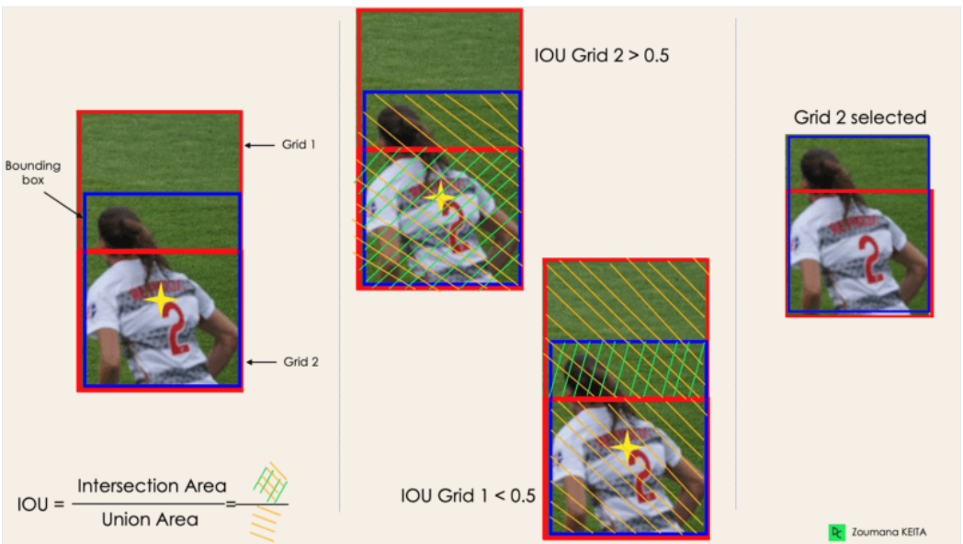
Here threshold =0.5(our assumption)

Slide 12
Non Max Suppression
Setting a threshold for the IOU is not always enough because an object can have multiple boxes with IOU beyond the threshold, and leaving all those boxes might include noise. Here is where we can use NMS to keep only the boxes with the highest probability score of detection.

Slide 13
How it detects?
The image is divided into grids of SxS size.
If center of the bounding box object is in that grid then this grid is responsible for detecting that object
Each grid predicts bounding boxes with their confidence score
Each confidence score shows how accurate is the bounding box predicted containing an object and how precise it predicts the box coordinates wrt. ground truth prediction

Slide 14
What is expected from YOLO
Works by dividing the input image into a grid of cells and predicting the probability of an object present in each cell along with object’s classes and it’s bounding box
Final Output:-List of bounding with corresponding class probabilities that represent the detected objects in the image

Slide 15
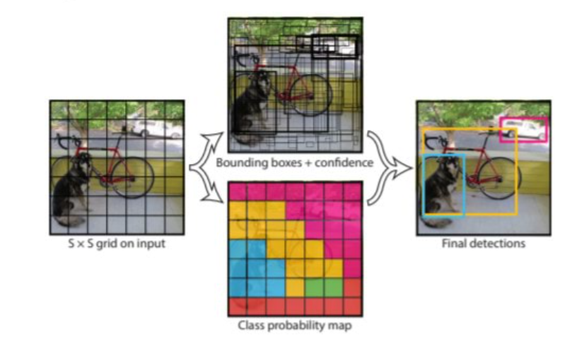

Slide 16
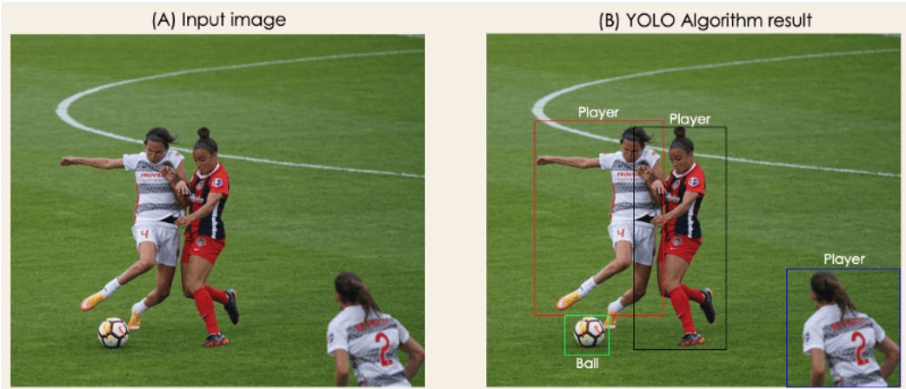

Slide 17
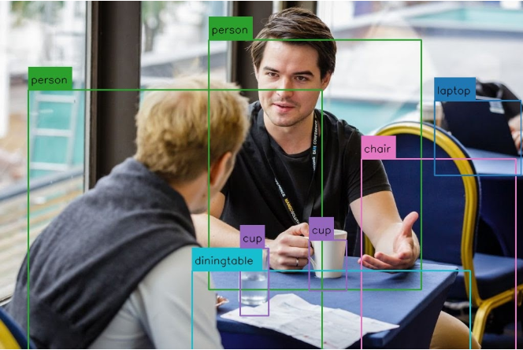

Slide 18
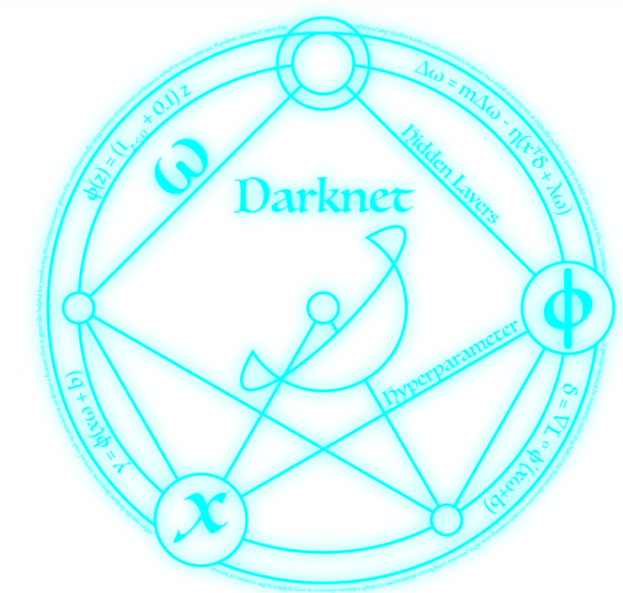
YOLO-Implementation
There are a few different implementations of the YOLO algorithm on the web. Darknet is one such open-source neural network framework. Darknet was written in the C Language and CUDAtechnology, which makes it really fast and provides for making computations on a GPU, which is essential for real-time predictions.

Slide 19
On what type of data sets it works better
Large datasets-because it can detect and classify multiple objects simultaneously
Diverse range of Object sizes and aspect ratios-
High variability in object appearance-it is robust to changes in lighting,color,texture,making it suitable for data sets with high degree of variability in object appearance
Complex Scenes-It can detect objects even when they are partially occluded by other objects

Slide 20
Benefits of YOLO
Better generalization of image
Processes frame at a rate of 45fps (larger network) to 150fps (smaller network)
Higher Accuracy
Excellent learning capabilities that enables it to learn it to learn representation of objects and apply them in detection.

Slide 21
Disadvantages of YOLO
Struggles to detect small objects
Struggles to detect objects because each grid can only 2 bounding boxes

Slide 22
Applications of YOLO

Slide 23
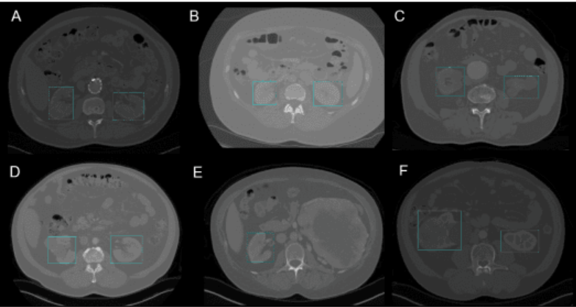
Healthcare
In surgery it can be challenging to localize organs in real time due to biological diversity of one patient to another.
YOLOv3 is used for kidney recognition in CT for localizing kidney from 2D to 3D in CT scans.

Slide 24
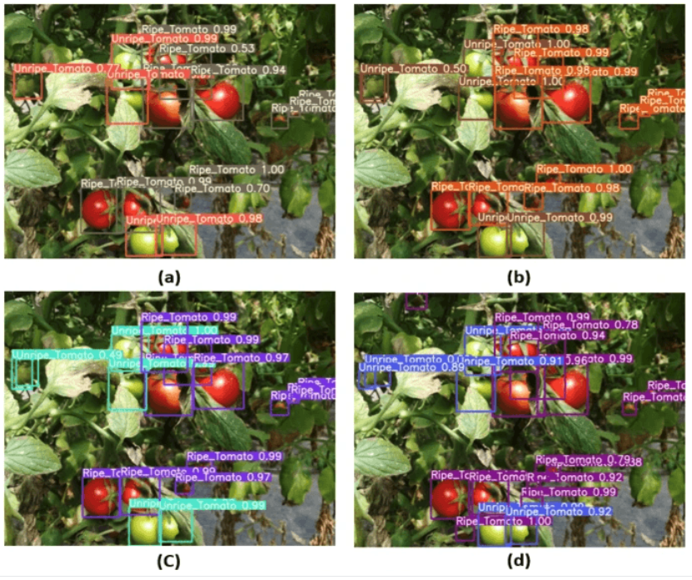
Agriculture
Identify different types of fruits for efficient harvest.

Slide 25
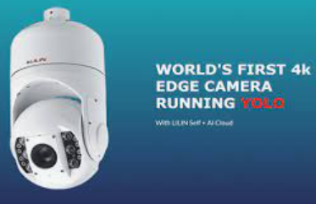
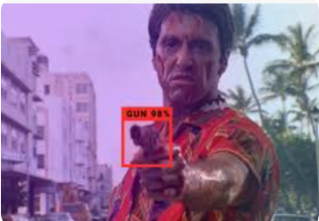
Security Survillience
YOLO can be used to detect and track people and objects in real-time, allowing for more efficient and effective monitoring of public spaces.
This technology has the potential to improve public safety and security, as well as aid in the prevention and investigation of crimes.

Slide 26
THANK YOU

